Slide 1
Causal inference in online systems: Methods, pitfalls and best practices
WORKSHOP: University of Michigan (2018)
From Prediction to Causation
Amit Sharma
Postdoctoral Researcher, Microsoft Research
amshar@microsoft.com
@amt_shrma
http://www.github.com/amit-sharma/causal-inference-tutorial

Slide 2
Session Objectives and Takeaways
What is causal inference? Why should we care?
Most machine learning algorithms depend on correlations.
Correlations alone are a dangerous path to actionable insights.
Learn how to formulate and estimate causal effects.
To evaluate the impact of online systems.
To make underlying algorithms more robust to changes in data.
Apply causal inference methods to a practical problem
Estimating the causal impact of a recommendation system.

Slide 3
Agenda
9am-11am: Introduction to causal inference
11:15am-12pm: Working with code
12-1:30pm: Lunch
1:30pm-2:30pm Advanced methods and a working example
3-4pm: Case studies and further curiosities

Slide 4
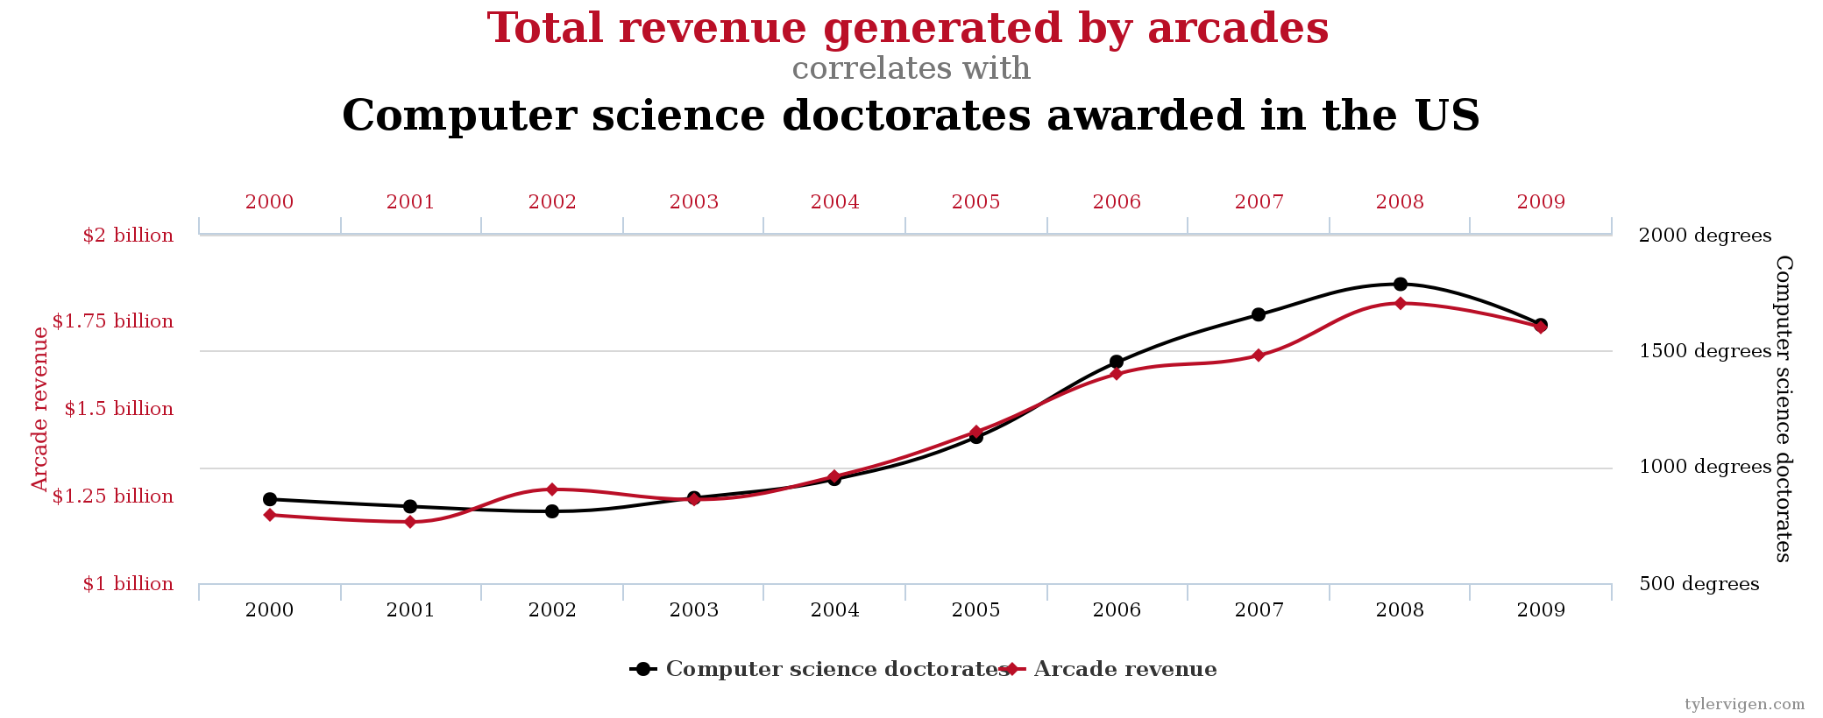
We have lots of data!
www.tylervigen.com
Notes:
And the motivation is…Salient theme Across science and business, we are generating lots of data than ever before.
This should mean that we should be increasing our causal knowledge about the world, but often, big data leads to graphs like this.
And this is true! There is almost perfect correlation between computer science phds and revenue generated by arcades, but at least from personal experience, I hope you will trust me, there was not a lot of arcade gaming in my phd experience. ..it’s most likely a useless correlation. [Now I did do a CS phd, so [trust me when I say this], there was little of/not a lot of arcade gaming.]
---
Very often, it leads to insightful conclusions like these.
Often, we are interested in causal questions, but invariably they turn out to be the hardest to answer. And so my overall research goal is to…
One of the reasons that it is hard is that the answer really depends on the data-generating process, and we never observe that in the data.

Slide 5
Observed data can be confounded, or even spurious.
www.tylervigen.com
Notes:
And the motivation is…Salient theme Across science and business, we are generating lots of data than ever before.
This should mean that we should be increasing our causal knowledge about the world, but often, big data leads to graphs like this.
And this is true! There is almost perfect correlation between computer science phds and revenue generated by arcades, but at least from personal experience, I hope you will trust me, there was not a lot of arcade gaming in my phd experience. ..it’s most likely a useless correlation. [Now I did do a CS phd, so [trust me when I say this], there was little of/not a lot of arcade gaming.]
---
Very often, it leads to insightful conclusions like these.
Often, we are interested in causal questions, but invariably they turn out to be the hardest to answer. And so my overall research goal is to…
One of the reasons that it is hard is that the answer really depends on the data-generating process, and we never observe that in the data.

Slide 6


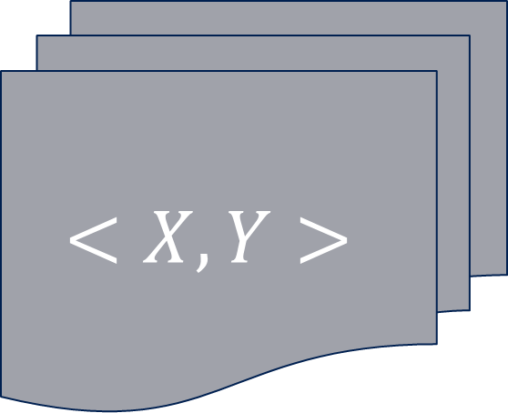
Prediction Causation
$$y=βx+ε$$
$$<X,Y>$$
?
$$\hat{y}$$
$$\hat{β}$$
Hofman, Sharma, and Watts (2017). Science, 355.6324
Notes:
So this tutorial is going to be about how to get better at it. Suppose a simple world. If you believe everything relevant is captured, go for prediction and you should be fine. But if not, need to understand causal factors. And btw, we will also learn that regression is one of the worst methods because the world is almost never linear.
One of the reasons is that while we have got pretty good at processing terabytes of data, causal inference methods haven’t caught up.
The example I like to think of is fundamentally the difference between prediction and causation, as I describe in a recent paper in Science. Suppose there are two variables and for simplicity, you believe that the true model of the world is given by beta x. But we know nothing about the error eta, it may not even be independent.
Prediction is what big data is often used for…so if we have a big dataset with two variables X and Y,
, we can simply feed it to a machine learning algorithm to get reasonable accurate predictions for y. However, often the most interesting questions are of a causal nature---does X cause Y---and here it is not entirely clear how to use big data:

Slide 7
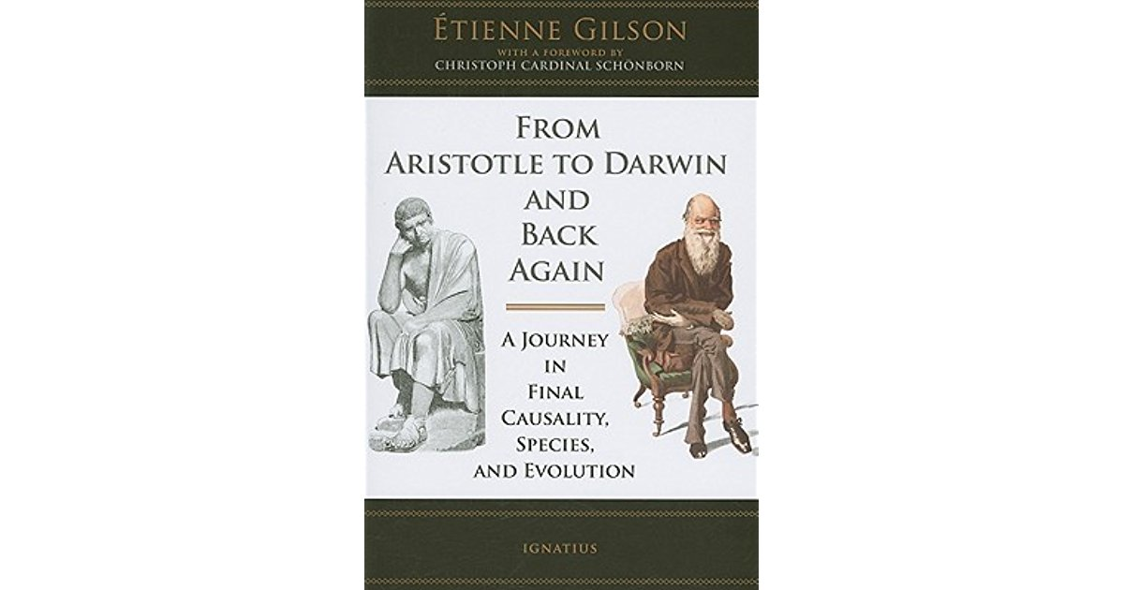
PART I: Causality, what?

Slide 8
I.A What is causality?

Slide 9
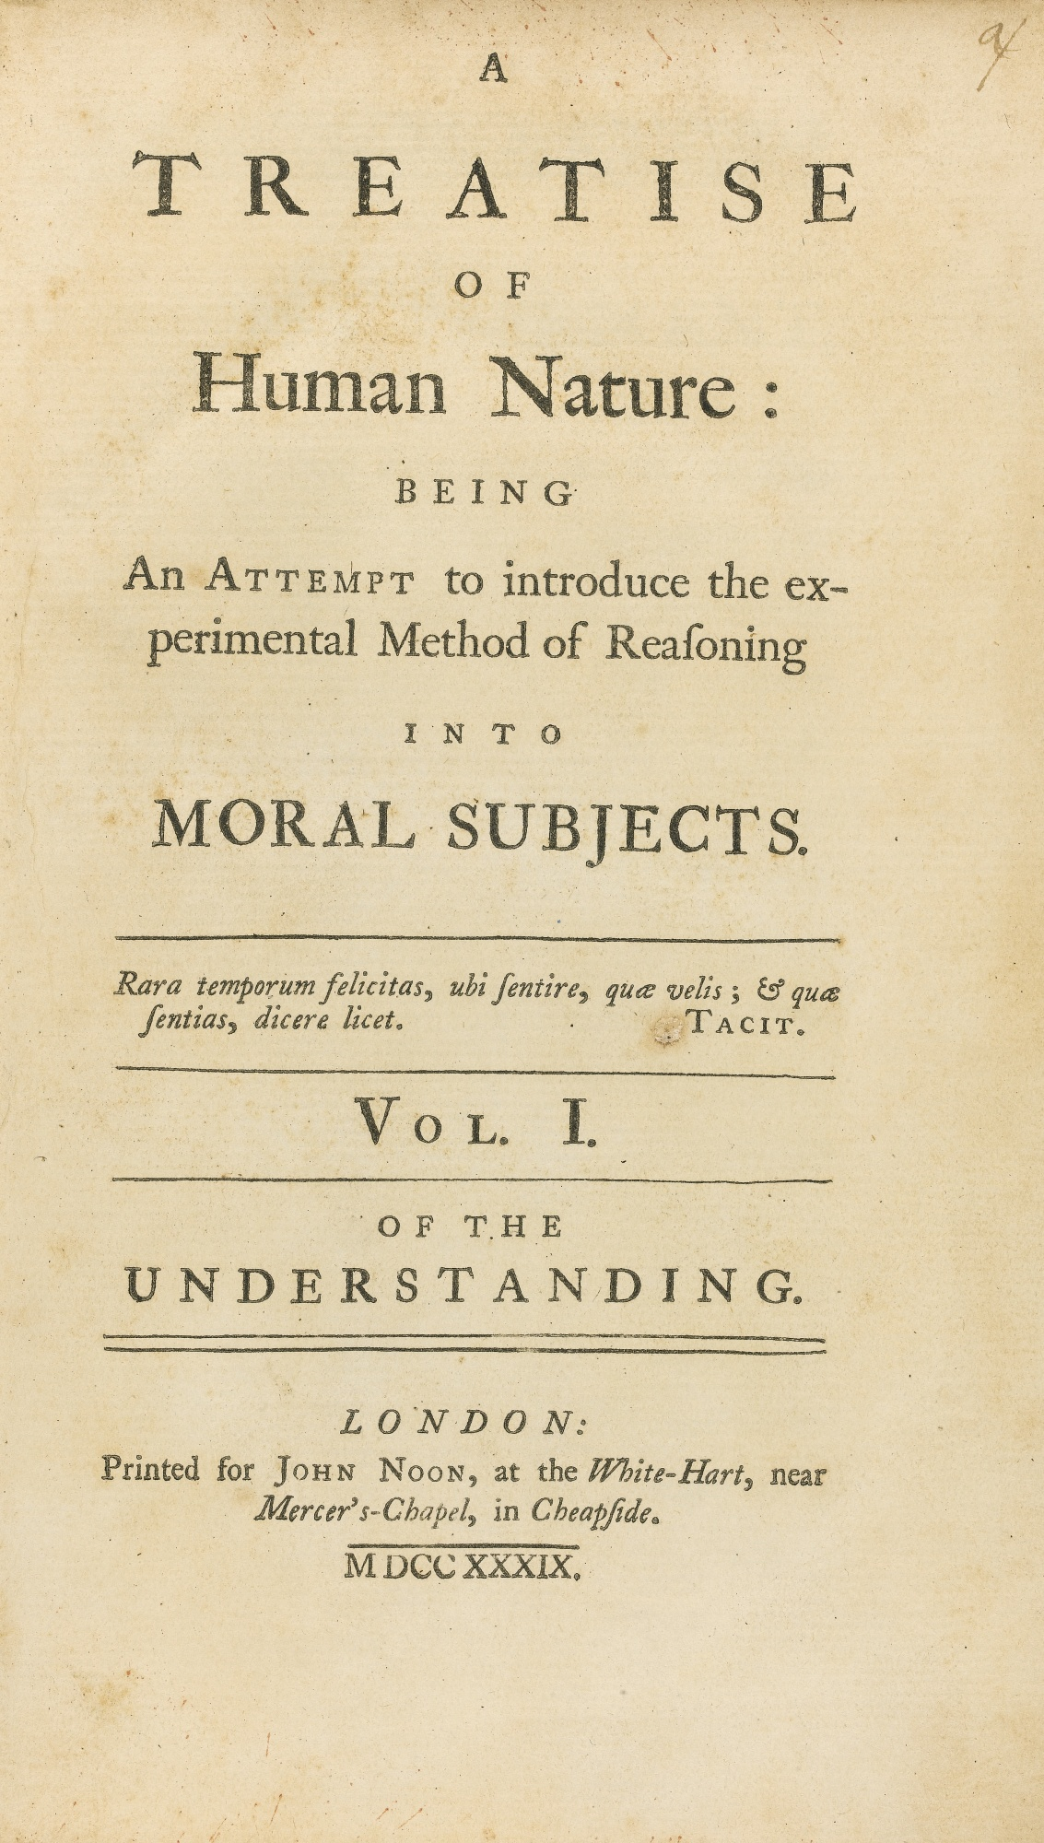


A question that has attracted scholars for centuries
Largely a philosophical pursuit for many centuries.
Notes:
Confined to philosophy.

Slide 10
--Gary King, Harvard University
“More has been learned about causal inference in the last few decades than the sum total of everything that had been learned about it in all prior recorded history”

Slide 11
--Gary King, Harvard University
“More has been learned about causal inference in the last few decades than the sum total of everything that had been learned about it in all prior recorded history”
A “causal revolution” is upon us.
--Judea Pearl, University of California Los Angeles

Slide 12
What are they talking about?
Notes:
We are all going fine..consider css, machine learning.

Slide 13
No one knows what causality means
Hume, 18th century
If you strike a match and it lights up, does the striking cause lighting?
What if you repeat the experiment 100 times?
How do you know that striking always leads to light? How is it different from regularity or predictability?
Does causality even exist?
Notes:
All you have seen are two events that happen one after another.

Slide 14
Still, everyone aims to find causal effects
Empirical causal inference is pragmatic, best-effort.
Concerns effect of actions that generalize to all reasonable contexts.
If I strike a match, would it light up (assuming that everything else stays the same)?
“A bag of tricks to produce knowledge!”
--Try the action multiple times
--Try controlling for the environment
--Somehow account for uncontrolled factors

Slide 15
A practical definition
Definition: X causes Y iff
changing X leads to a change in Y,
keeping everything else constant.
The causal effect is the magnitude by which Y is changed by a unit change in X.
Called the “interventionist” interpretation of causality.
*Interventionist definition [http://plato.stanford.edu/entries/causation-mani/]

Slide 16
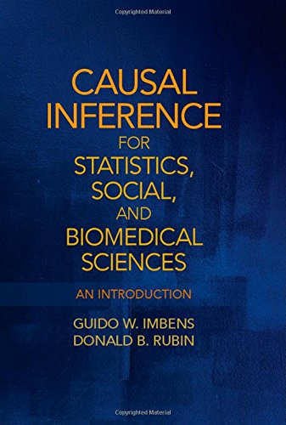
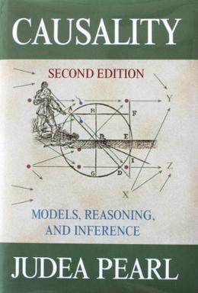
Bag of tricks => Powerful statistical frameworks
Potential Outcomes
Bayesian Networks
Notes:
ready for anyone with a causal question.

Slide 17
I.B Why should we care? We have increasing amounts of data and highly accurate predictions. How is causal inference useful?

Slide 18
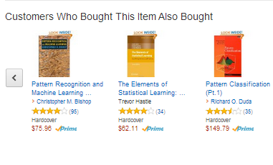
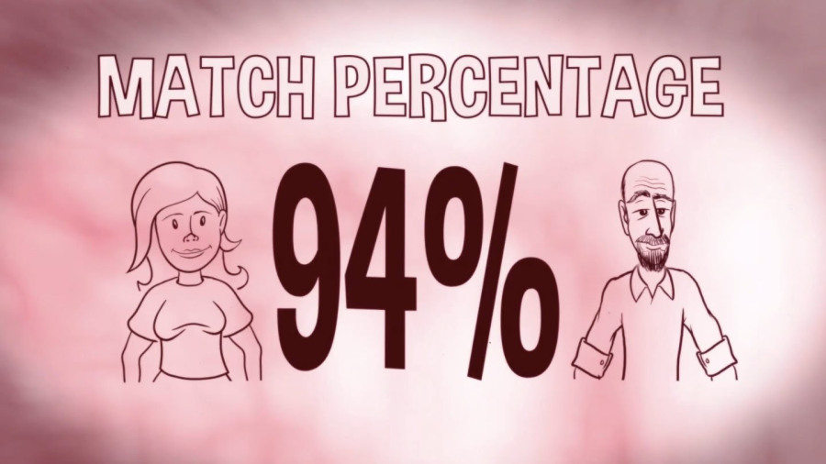
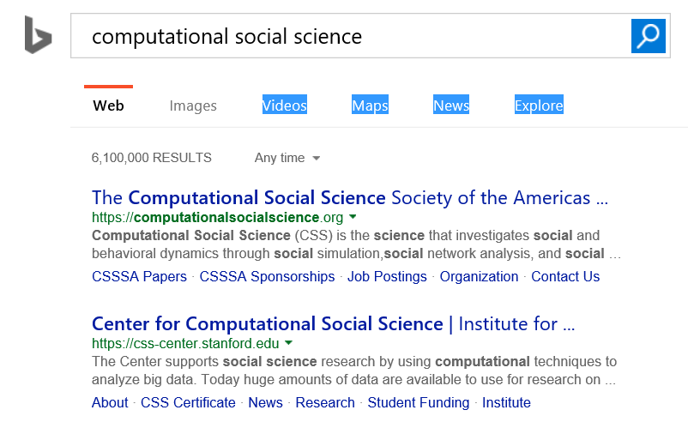

Predictive systems are everywhere

Slide 19


How do predictive systems work?
Aim: Predict future activity for a user.
We see data about their user profile and past activity.
E.g., for any user, we might see their age, gender, past activity and their social network.
…

Slide 20
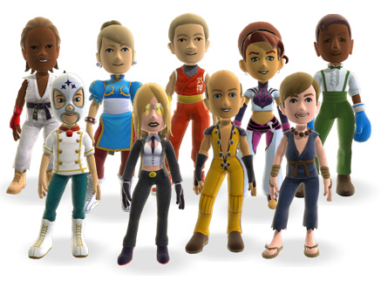
From data to prediction
Higher Activity Lower Activity
✗
Use these correlations to make a predictive model.
Future Activity ->
f(number of friends, logins in past month)

Slide 21
From data to “actionable insights”
Number of friends can predict activity with high accuracy.
How do we increase activity of users?
Would increasing the number of friends increase people’s activity on our system?
Maybe, may be not (!)

Slide 22
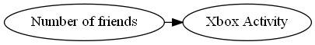
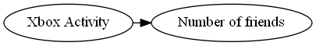
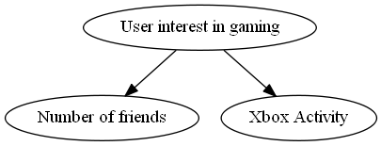
Different explanations are possible
How do we know
what causes what?
Decision: To increase activity, would it make sense to launch a campaign to increase friends?

Slide 23


Another example: Search Ads
Search engines uses ad targeting to show relevant ads.
Prediction model based on user’s search query.
Search Ads have the highest click-through rate (CTR) in online ads.

Slide 24
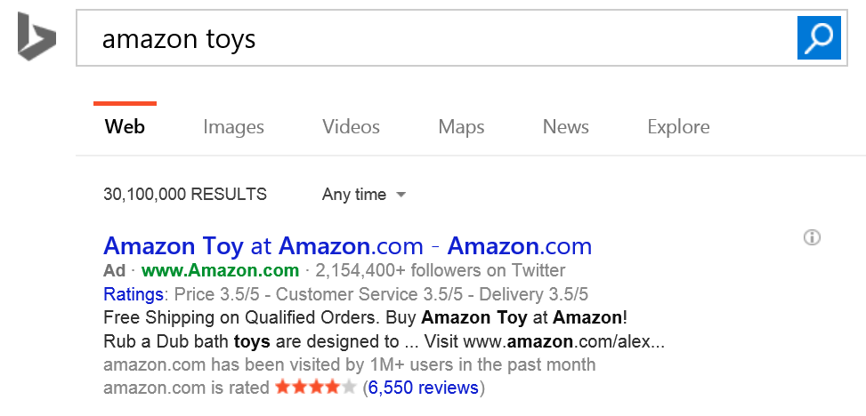
Are search ads really that effective?
Ad targeting was highly accurate.
Blake-Tadelis-Noskos (2014)

Slide 25
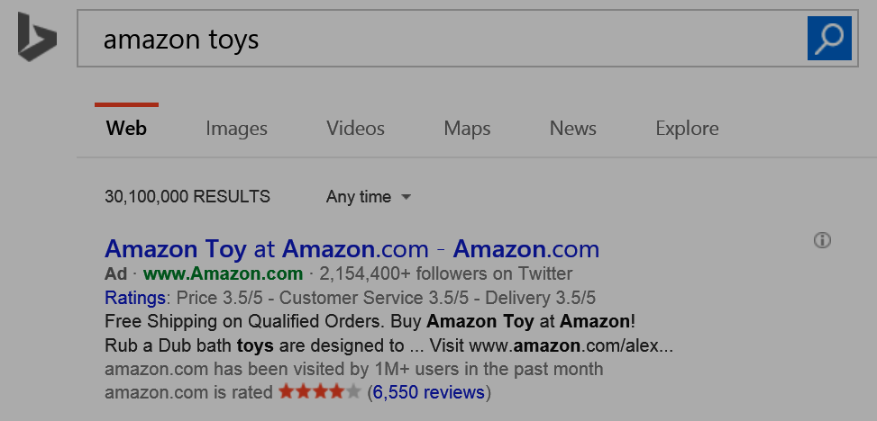
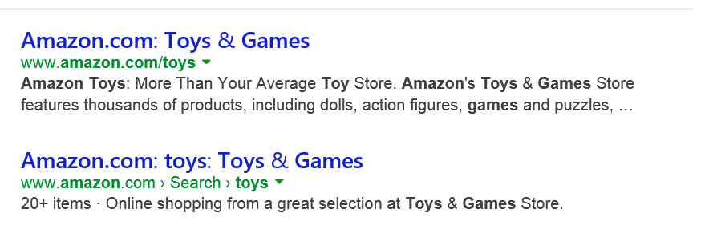
But search results point to the same website
Counterfactual question: Would I have reached Amazon.com anyways, without the ad?

Slide 26
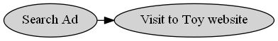
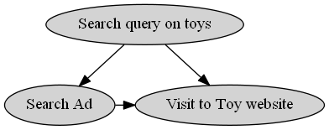
Without reasoning about causality, may overestimate effectiveness of ads
x% of ads shown are effective
<x% of ads shown are effective

Slide 27
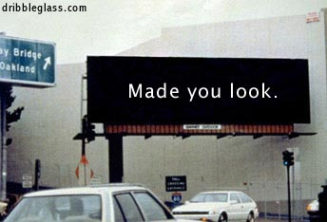
Okay, search ads have an explicit intent. Display ads should be fine?
Probably not.
There can be many hidden causes for an action, some of which may be hard to quantify.

Slide 28


Estimating the impact of ads
Toys R Us designs new ads.
Big jump in clicks to their ads compared to past campaigns. Were these ads more effective?

Slide 29
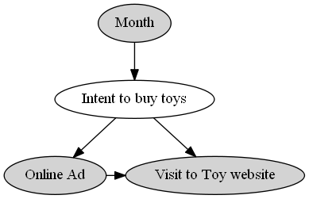
People anyways buy more toys in December
Misleading to compare ad campaigns with changing underlying demand.

Slide 30
So far, so good. Be mindful of hidden causes, or else we might overestimate causal effects.

Slide 31
(But) Ignoring hidden causes can also lead to completely wrong conclusions.

Slide 32

Example: Did a system change lead to better outcomes?
Have a current production algorithm. Want to test if a new algorithm is better.
Say a feature that provides information or discount for a financial product.
?
Algorithm A
Algorithm B

Slide 33
Comparing old versus new algorithm
Two algorithms, A (production) and B (new) running on the system.
From system logs, collect data for 1000 sessions for each. Measure Success Rate (SR).
Old Algorithm (A) | New Algorithm (B)
50/1000 (5%) | 54/1000 (5.4%)
New algorithm is better?

Slide 34
Change in SR by income of people
So let us look at
SR separately.
Old Algorithm (A) | New Algorithm (B)
10/400 (2.5%) | 4/200 (2%)
Low-income Users
Old Algorithm (A) | New Algorithm (B)
40/600 (6.6%) | 50/800 (6.2%)
High-income Users

Slide 35
The Simpson’s paradox
 | Old algorithm (A) | New Algorithm (B)
CTR for Low-Activity users | 10/400 (2.5%) | 4/200 (2%)
CTR for High-Activity users | 40/600 (6.6%) | 50/800 (6.2%)
Total CTR | 50/1000 (5%) | 54/1000 (5.4%)
Is Algorithm A better?
Simpson (1951)

Slide 36
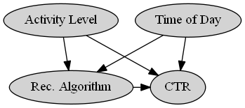
Answer (as usual): May be, may be not.
E.g., Algorithm A could have been shown at different times than B.
There could be other hidden causal variations.

Slide 37
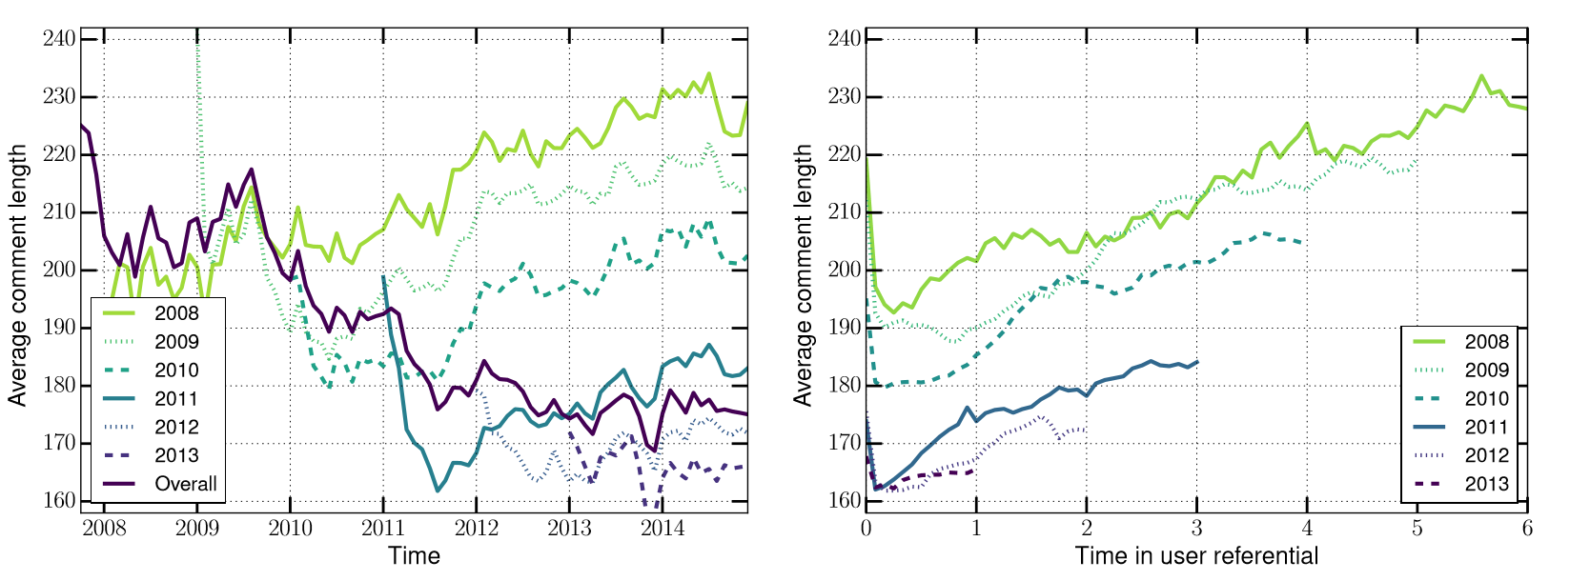
Example: Simpson’s paradox in Reddit
Average comment length decreases over time.
But for each yearly cohort of users, comment length increases over time.
Barbosa-Cosley-Sharma-Cesar (2016)

Slide 38

Making sense of such data can be too complex.

Slide 39

PART II: Causal inference basics

Slide 40
II.A In search of an intervention and a counterfactual: A historical tour of causal inference

Slide 41
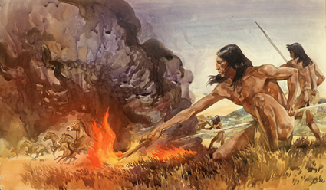
…And there was fire!
Action: Strike stones.
Outcome: Sparks? Fire?
Probably one of the oldest experiments in causal inference.
Intervention: Taking an action.
Notes:
As we saw, fire is a good example. In fact, we could say that those who did this, were probably the first causal inferrers.

Slide 42
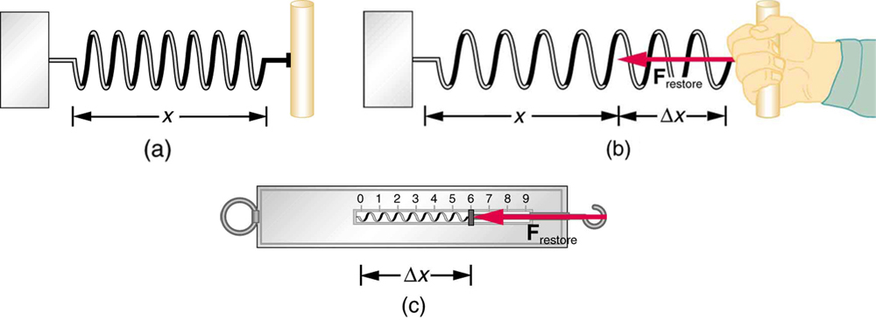
The idea of a “controlling” while taking action
Hooke discovered that pulling a spring causes it to expand in length proportional to the amount of the force applied. [Hooke’s law]
Only works if the other end is fixed, or controlled.
A common property of many physical experiments, leading to the notion of a “controlled” experiment.
Intervention: Taking an action while keeping other relevant factors constant.

Slide 43
What if you cannot intervene?
For centuries, controlled experiments have worked well for many physical experiments and do so even today.
However, they do not work in the messier life sciences or social sciences.
We needed another big idea for causality to branch out of physical experiments.
The idea of a “counterfactual”.

Slide 44
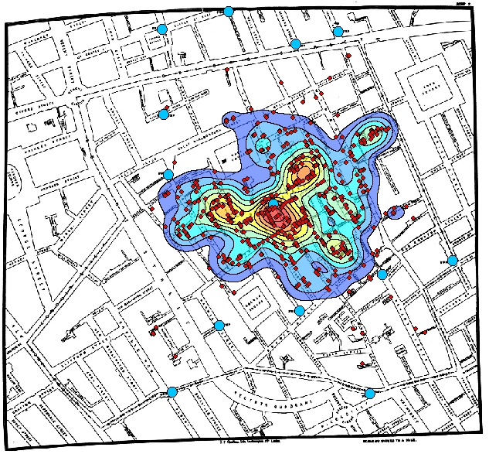
1854: London was having a devastating cholera outbreak
Notes:
London was having outbreak. Causal question: what was causing cholera so you can stop it?
There was theory that miasma (air ) or water.
.and they could see some areas more affected, but couldn’t say why..can predict but not cause.
Let’s start with a bit of history and for that, let me tell you a story.

Slide 45
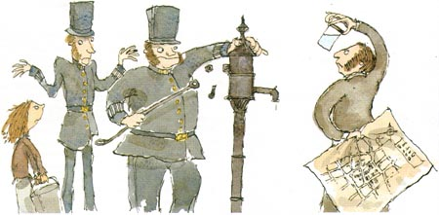
Enter John Snow. He found higher cholera deaths near a water pump, but could be just correlational.
Notes:
How much increase? Check before ppt.

Slide 46
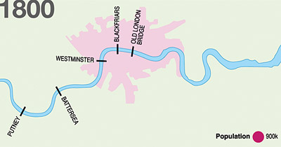
S & V WATER COMPANY
LAMBETH WATER COMPANY
New Idea: Two major water companies for London:
one upstream and one downstream.
Notes:
Use these two slides to show exclusion and asifrandom one by one in words.
This means one of them was contaminated water.
SOUTHWARK & VAUXHALL company

Slide 47
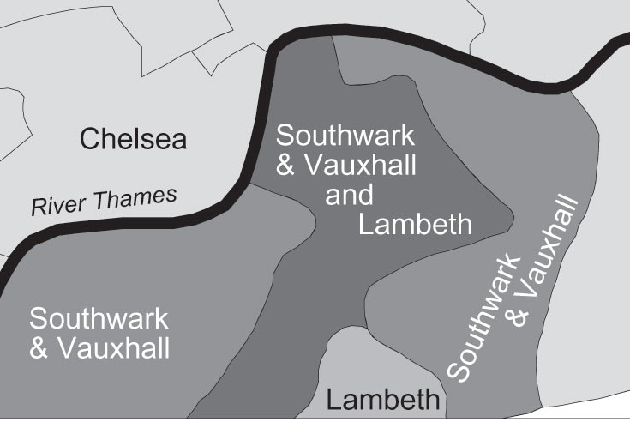
S&V
and Lambeth
No difference in neighborhood, still an 8-fold increase in cholera with the downstream company.
Notes:
8-fold increase..so got to know.
Found 2 companies, one of which served bad water..and there was 8-fold difference.
People found this convicing and now we all know that Cholera is a water-borne disease.

Slide 48
Real world
Acting in the Real world
INTERVENTION
Observed Data from the Real world
No data from the Counterfactual world
COUNTERFACTUAL
Notes:
Intervention only works in clean physical systems
Counterfactual very creative.
How about combining them?

Slide 49
Fisher experiment
A way to combine the ideas of an intervention and counterfactual.
Q. : Estimate the effect of fertilizers.
Controlled experiment

Slide 50
Fisher experiment
A way to combine the ideas of an intervention and counterfactual.
Q. : Estimate the effect of fertilizers.
Natural experiment

Slide 51
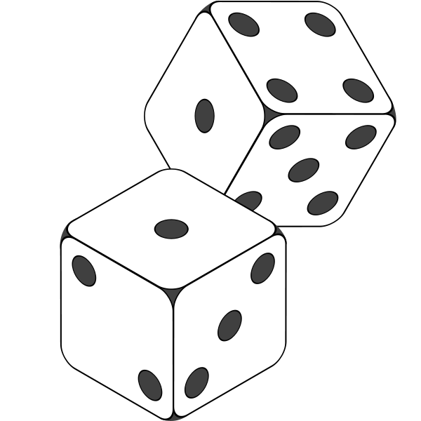
Fisher experiment
A way to combine the ideas of an intervention and counterfactual.
Q. : Estimate the effect of fertilizers.
Randomized Controlled experiment

Slide 52


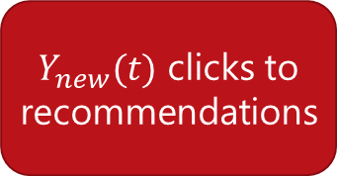


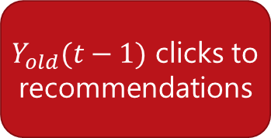
Ideal experiment
Naïve estimate
$$Y_{new}(t)−Y_{old}(t−1)$$
Old Algorithm
$Y_{old}(t−1)$ clicks to recommendations
Causal estimate
$$Y_{new}(t)−Y_{old}(t)$$
New Algorithm
Old Algorithm
$Y_{new}(t)$ clicks to recommendations
$Y_{old}(t)$ clicks to recommendations
Cloned user
Ideally, requires creation of multiple worlds.

Slide 53
II.B How do we systematically reason about and estimate the relationship between effects and their causes?

Slide 54
Two questions leading from Fisher’s work
What if you have a complicated randomized experiment?
E.g. Instead of plots, randomized at the level of farmers. But all farmers may not comply.
What if you could not randomize but had a lot of historical data?
E.g. Yield and fertilizer data for thousands of plots.

Slide 55

Two questions leading from Fisher’s work
1. Need a language for “complicated” questions.
Counterfactuals cannot be expressed by probability.
Try “If the fertilizer was applied, what is the probability that the yield was greater than $c$, in case that the fertilizer was not applied?
$P(Y≥c|F=applied, F=\sim applied)$
Pearl’s graphical model framework

Slide 56

Two questions leading from Fisher’s work
1. Need a language for “complicated” questions.
Counterfactuals cannot be expressed by probability.
Try “If the fertilizer was applied, what is the probability that the yield was greater than $c$, in case that the fertilizer was not applied?
$P(Y≥c|F=applied, F=\sim applied)$
→ Pearl’s graphical model framework
2. Need an estimation framework that understands this language.
Methods for estimating a causal quantity.
→ Neyman-Rubin’s potential outcome framework

Slide 57
Aside: Formulating causal inference problems
Causal inference: Principled basis for both experimental and non-experimental methods.
Such questions form the basis of almost all scientific inquiry.
E.g., occur in medicine (drug trials, effect of a drug), social sciences (effect of a certain policy), and genetics (effect of genes on disease).
Frameworks:
Causal graphical models [Pearl 2009]
Potential Outcomes Framework [Imbens-Rubin 2016]

Slide 58

Graphical Models: Express causal relationships visually
𝑐𝑡𝑟=𝑓(𝑎𝑙𝑔, 𝑎𝑐𝑡, time)
a$lg=g(act,time)$
Edges represent direct causes.
Directed paths represent indirect causes.

Slide 59

Graphical Models: Express causal relationships as a Bayesian network
Markov condition: A node is independent of all other non-descendants given its parents.
Leads to factorization of joint probability.
$$P(G) = P(Activity)P(Time) P(Alg|Activity,Time)P(CTR|Alg, Time)$$

Slide 60
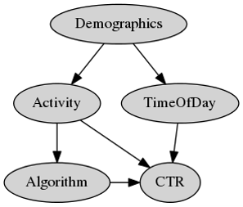
Graphical Models: Make assumptions explicit
The graph encodes all causal assumptions.
Assumptions are the nodes and edges that are missing.

Slide 61

Example: Assumptions encoded in the graph
$Activity$ level of users affects which $Algorithm$ they are shown and their overall $CTR$.
$CTR$ is different at different times of day.
Unobserved $Demographics$ of a user determine when they visit the Store, which also affects their $Activity$ level, and in turn the $Algorithm$ they are shown.

Slide 62

Graphical Models: A language for intervention and counterfactual
Intervention on a node: Acting to change the node exogenously by severing its ties to its parents.
$$P(CTR| do(Alg)$$
which is different from $P(CTR|Alg)$

Slide 63

Graphical Models: A language for intervention and counterfactual
Counterfactual: The recommendations were always shown. But what would have happened if they were not?
$$P(CTR|do\left(\sim Alg\right), Alg)$$

Slide 64
Graphical models: Provide an mechanistic way of identifying a causal effect
Appeals to the idea of controlling.
When we cannot control the environment, use conditioning.
Notes:
Give examples of both controlling and conditioning.

Slide 65
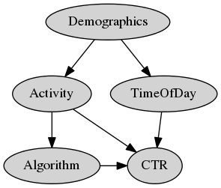

Should we also restrict our comparison to people who come at the same times?
$CTR$ does depend on $Time of Day$ of a user’s visit.
But the algorithm assigned does not change based on $Time of Day$.
$⇒$ While $CTR$ may be different at different times, any $Algorithm$ is equally likely to be shown at any point in time.

Slide 66
Tricky to find correct variables to condition on. Fortunately, graphical models make it precise.
“Backdoor” paths: Look for (undirected) paths that point to both $Algorithm$ and $CTR$.
Pearl (2009)

Slide 67

Backdoor criterion: Condition on enough variables to cover all backdoor paths
Identified Causal Effect:
$$P\left(CTR | do\left(Alg\right)\right)=\sum_{activity}{P\left(CTR | Alg, Activity\right)P(Activity)}$$

Slide 68

Wait, but how to estimate this?
Identified Causal Effect:
$$P\left(CTR | do\left(Alg\right)\right)=\sum_{activity}{P\left(CTR | Alg, Activity\right)P(Activity)}$$
For complicated graphs, do-calculus provides a set of rules to automate the identification process.

Slide 69

Potential Outcomes: Every variable has a counterfactual
Imagine $Y_{Alg} and Y_{\sim Alg}$
Need to estimate difference between the real and counterfactual world.
$$E\left[Y_{Alg}]−E[Y_{\sim Alg}\right]=E\left[Y | do\left(Alg\right)\right]−E[Y|do(\sim Alg)]$$
This formulation has led to some powerful methods for estimating causal effect.
Equivalent to graphical models.

Slide 70

Potential Outcomes: Estimating an effect identified from the backdoor criterion
Imagine $Y_{Alg} and Y_{\sim Alg}$
Causal effect:
$$E\left[Y_{Alg}]−E[Y_{\sim Alg}\right]=E\left[Y | do\left(Alg\right)\right]−E\left[Y | do\left(\sim Alg\right)\right]$$
$=E\left[Y | Alg, Activity\right]−E[Y|\sim Alg, Activity]$
Can estimate using regression.
$$y=α+βAlg+γActivity+ε$$
Valid if all effects are linear.
Notes:
But many other methods can be derived.

Slide 71
Unifying the two frameworks
Use graphical models and do-calculus for
modeling the world
identifying the causal effect
Use potential outcomes-based methods for
estimating the causal effect

Slide 72
II.C Different ways to identify and estimate causal effect

Slide 73
Running example: Estimating effect of an algorithm
$$P(CTR|do\left(Algorithm\right))$$

Slide 74
Lookback: Need answers to “what if” questions
Counterfactual thinking*:
What would have happened if I had changed X?
E.g. What would have been the CTR had we not shifted to the new algorithm?
*Counterfactual theories of causation
http://plato.stanford.edu/entries/causation-counterfactual/

Slide 75
Ideal experiment
Naïve estimate
$$Y_{new}(t)−Y_{old}(t−1)$$
Old Algorithm
$Y_{old}(t−1)$ clicks to recommendations
Causal estimate
$$Y_{new}(t)−Y_{old}(t)$$
New Algorithm
Old Algorithm
$Y_{new}(t)$ clicks to recommendations
$Y_{old}(t)$ clicks to recommendations
Cloned user
Ideally, requires creation of multiple worlds.

Slide 76
Methods for answering causal questions
Randomization
A/B test
Multi-armed bandits
Natural Experiments
Regression discontinuity
Instrumental Variables
Conditioning
Stratification, Matching
Propensity Scores
VALIDITY
EASE OF USE

Slide 77
1. Randomization to the rescue

Slide 78
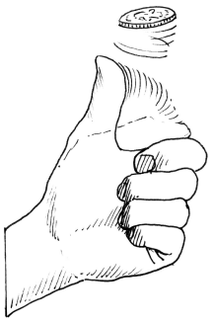
Randomizing algorithm assignment: A/B test
We cannot clone users.
Next best alternative: Randomly assign which users see new Algorithm’s recommendations and which see the old algorithm’s.

Slide 79

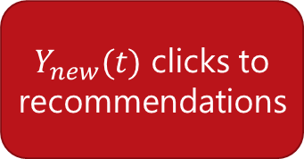
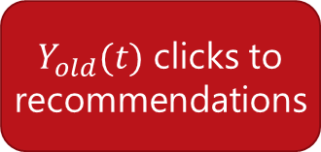

Randomization removes hidden variation
Old Algorithm
$Y_{old}(t−1)$ clicks to recommendations
…
Causal estimate
$$Y_{new}(t)−Y_{old}(t)$$
New Algorithm
Old Algorithm
$Y_{new}(t)$ clicks to recommendations
$Y_{old}(t)$ clicks to recommendations
Random User 1
Random User 2

Slide 80
Cost: Possibly risky, unethical
Say the new algorithm was really bad.
Can decrease the percentage of users who see the new algorithm, but how do we know this beforehand?
Such manual tweaks even more inefficient if multiple algorithms to test.

Slide 81

Efficient randomization: Multi-armed bandits
Two goals:
Show the best known algorithm to most users.
Keep randomizing to update knowledge about competing algorithms.

Slide 82

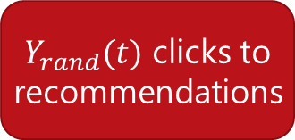

Bandits: The right mix of explore and exploit
Old Algorithm
$Y_{old}(t−1)$ clicks to recommendations
…
Current-best Algorithm
Random Algorithm
$Y_{new}(t)$ clicks to recommendations
$Y_{rand}(t)$ clicks to recommendations
Most users
Other users

Slide 83
Algorithm: ɛ-greedy multi-armed bandits
Repeat:
(Explore) With low probability ɛ, choose an output item randomly.
(Exploit) Otherwise, show the current-best algorithm.
Use CTR results for Random output items to train new algorithms offline.

Slide 84
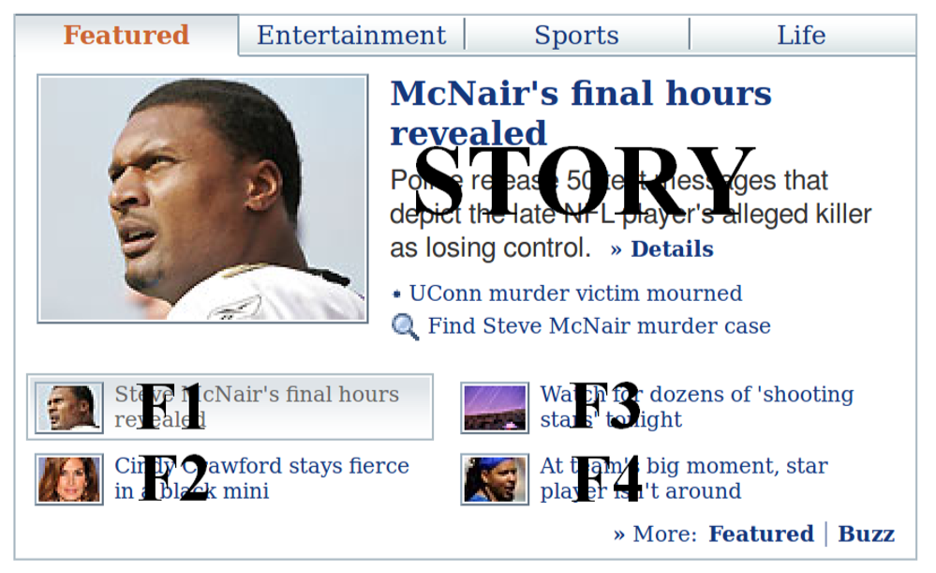
Practical Example: Contextual bandits on Yahoo! News
Actions: Different news articles to display
A/B tests using all articles inefficient.
Randomize the articles shown using ɛ-greedy policy.
Better: Use context of visit (user, browser, time, etc.) to have different current-best algorithms for different contexts.
Li-Chu-Langford-Schapire (2010)

Slide 85
Caveat: Not always feasible to randomize, or ensure that people fully comply
Randomization may be too expensive or involve ethical hazards.
There may not be perfect compliance with random assignment. E.g. referral experiment for a subscription service like Netflix.
Even when feasible, randomization methods need a limited set of "good" alternatives to test.
How do we identify a good set of algorithms or a good set of parameters?
Common metrics like CTR will not be useful, because they might miss hidden causes.
Need causal inference “without intervention”.

Slide 86
2. So how about naturally occurring experiments?

Slide 87
“Natural” experiments: exploit variation in observed data
Can exploit naturally occurring close-to-random variation in data.
Since data is not randomized, need assumptions about the data-generating process.
If there is sufficient reason to believe the assumptions, we can estimate causal effects.
Dunning (2002), Rosenzweig-Wolpin (2000)

Slide 88
Example: Effect of Store recommendations
Suppose instead of comparing recommendation algorithms, we want to estimate the causal effect of showing any algorithmic recommendation.
Can be used to benchmark how much revenue a recommendation system brings, and allocate resources accordingly.
(and perhaps help analyze the tradeoff with users’ privacy)

Slide 89

Exploiting arbitrary cutoffs to recommendations
Only 3 recommendations shown to user.

Slide 90

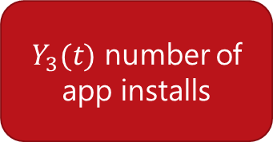
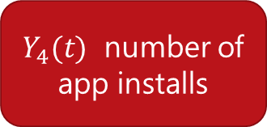
Assumption: Closely-ranked not-shown apps are as relevant as shown apps
Causal effect of being shown as recommendation
$$Y_{3}(t)−Y_{4}(t)$$
3rd ranked app (Shown)
4th ranked app
(Not-shown)
$Y_{3}(t)$ number of app installs
$Y_{4}(t)$ number of app installs
Same user

Slide 91
Algorithm: Regression discontinuity
For any top-k recommendation list:
Using logs, identify apps that were similarly ranked but could not make it to the top-k shown apps.
Measure difference in app installs between shown and not-shown apps for each user.
Imbens-Lemieux (2008)

Slide 92
Another natural experiment: Instrumental Variables
Can look at as-if random variations due to external events.
E.g. Featuring on the Today show may lead to a sudden spike in installs for an app.
Such external shocks can be used to determine causal effects, such as the effect of showing recommendations.
Angrist-Pischke (2008)

Slide 93
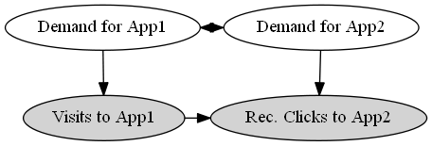

Cont. example: Effect of store recommendations
How many new visits are caused by the recommender system?
Demand for App 1 is correlated with demand for App 2.
$⇒$ Users would most likely have visited App 2 even without recommendations.

Slide 94
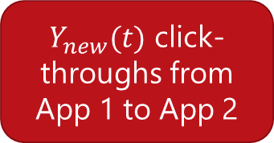
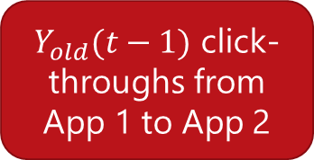
Traffic on normal days to App 1
$Y_{old}(t−1)$ click-throughs from
App 1 to App 2
Cannot say much about the causal effect of recommendations from App 1.
$Y_{new}(t)$ click-throughs from
App 1 to App 2

Slide 95
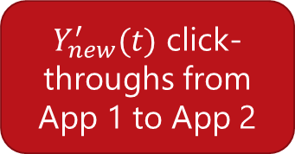

External shock brings as-if random users to App1
$Y_{old}(t−1)$ click-throughs from
App 1 to App 2
Spike in visits to App 1
If demand for App 2 remains constant, additional views to App 2 would not have happened had these new users not visited App 1.
$$Causal clicks =Y_{new}^{′}\left(t\right)−Y_{old}(t−1)$$
$Y_{new}^{′}(t)$ click-throughs from
App 1 to App 2
Sharma-Hofman-Watts (2015)

Slide 96
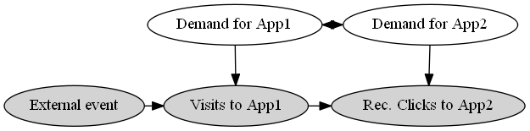

Exploiting sudden variation in traffic to App 1
To compute Causal CTR of Visits to App1 on Visits to App2:
Compare observed effect of external event separately on Visits to App1, and on Rec. Clicks to App2.
Causal click-through rate =$\frac{\text{Δ}\text{(}\text{Rec}\text{. }\text{Click}\text{−}\text{throughs} \text{from} \text{App}\text{1 }\text{to} \text{App}\text{2)}}{\text{Δ}\text{(}\text{Visits} \text{to} \text{App}\text{1)}}$

Slide 97


More generally…
Unobserved Confounders (U)
As-If-Random
$$(Z \text{∐ }\text{U}\text{)}$$
Instrument(Z)
Cause (X)
Outcome (Y)
$$(Z ∐ Y | X,U)$$
Exclusion

Slide 98

$$<X,Y>$$
Lottery
Weather
Shocks
Discontinuities
Hard-to-find
variations
Dunning (2012)
Notes:
For instance, we might know about a lottery and analyze the data connected to it, or affected by weather or other kinds of shocks.
Apart from these, good sources of natural variation[, or instrumental variables,] are really hard to find.
This restricts causal estimates to a small portion of the available data, and hurts generalizability: it’s really hard to know whether such estimates will generalize to the full population.

Slide 99






$$<X,Y>$$
Lottery
Weather
Change in access of digital services
Shocks
Discontinuities
Change in train stops in a city
Hard-to-find
variations
Change in medicines at a hospital
…
Notes:
For instance, as I speak, there might be many valid natural experiments being generated. One of the web services such as Twitter may be experiencing network problems in some areas, creating a change in how people access articles and other content. A subway train in new York may have changed its stops and let people off at different stops than they usually do, thus creating a natural experiment on peoples’ location. Or a hospital may run of a particular medicine and doctors may be prescribing a different treatment for patients.
If there was a way to identify even some of these natural experiments, that would be golden.
---
Natural experiments identify small subsets.
Change: twitter or reddit down for some section, or just slow.
change: on some day, a train does not stop at a station
Medicine runs out at hospital doctors prescribe its alternative.
Think about org event, or Wikipedia collab, or TV, delay in packets for discount mailers, or donation request for nonprofit.

Slide 100
Caveat: Natural experiments are hard to find
Estimates may not be generalizable to all products.
Critical assumptions may not be satisfied.
Both sources of experimentation:
Controlled
Natural
ruled out.
Can we estimate causal effects with only observational data?

Slide 101
3. What can we conclude with observed data?

Slide 102
Imagine a randomized experiment…
Old Algorithm
$Y_{old}(t−1)$ clicks to recommendations
…
New Algorithm
Old Algorithm
$Y_{new}(t)$ clicks to recommendations
$Y_{old}(t)$ clicks to recommendations
Random User 1
Random User 2

Slide 103

Compare with a similar user instead of random
Old Algorithm
$Y_{old}(t−1)$ clicks to recommendations
…
Causal estimate
$≈ Y_{new}(t)−Y_{old}(t)$
New Algorithm
Old Algorithm
$Y_{new}(t)$ clicks to recommendations
$Y_{old}(t)$ clicks to recommendations
User 1
Similar User 2

Slide 104
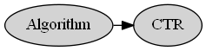
Continuing example: Effect of Algorithm on CTR
Make assumptions about how the data as generated.
Create a graphical model representing those assumptions.
Does new Algorithm B increase CTR for recommendations on Windows Store, compared to old algorithm A?

Slide 105
Previous example: Effect of Algorithm over CTR
Does new Algorithm B increase CTR for recommendations on Windows Store, compared to old algorithm A?
Make assumptions about how the data as generated.
Create a graphical model representing those assumptions.

Slide 106
Assumptions to estimate effect of Algorithm
$Activity$ level of users affects which $Algorithm$ they are shown and their overall $CTR$.
$CTR$ is different at different times of day.
Unobserved $Demographics$ of a user determine when they visit the Store, which also affects their $Activity$ level, and in turn the $Algorithm$ they are shown.

Slide 107

General method: Conditioning on variables
Intuition: Compare effect of algorithm on similar users.
$⇒$Compare users with the same activity level.
Steps:
Stratify log data based on activity levels.
Compare CTR of different algorithms within these strata.

Slide 108
Should we also restrict our comparison to people who come at the same times?
$CTR$ does depend on $Time of Day$ of a user’s visit.
But the algorithm assigned does not change based on $Time of Day$.
$⇒$ While $CTR$ may be different at different times, any $Algorithm$ is equally likely to be shown at any point in time.

Slide 109
Tricky to find correct variables to condition on. Fortunately, graphical models make it precise.
Backdoor paths: Look for (undirected) paths that point to both $Algorithm$ and $CTR$.
Pearl (2009)

Slide 110
Backdoor criterion: Condition on enough variables to cover all backdoor paths

Slide 111
Algorithm: Stratification
With observational data:
Assume a graphical model that explains how the data was generated.
Choose variables to condition on using backdoor criterion.
Stratify data into subsamples such that each subsample has the same value of all conditioned variables.
Evaluate the difference in outcome variable separately within these strata.
(Optional) Aggregate over all data.

Slide 112
Stratification may be inefficient if there are multiple hidden causes
Stratification creates tiny strata when data is high-dimensional. Hard to obtain stable estimates.
E.g. activity data may be high-dimensional: a vector for purchases in each app category.
Key Idea: Instead of conditioning on all relevant attributes, can condition on the likelihood of being assigned an Algorithm.
Morgan-Winship (2014)

Slide 113
This was stratification…
Old Algorithm
$Y_{old}(t−1)$ clicks to recommendations
User 2 and User 1 are the same on all relevant attributes.
…
New Algorithm
Old Algorithm
$Y_{new}(t)$ clicks to recommendations
$Y_{old}(t)$ clicks to recommendations
User 1
Similar User 2

Slide 114
Instead condition on propensity to treatment
Old Algorithm
$Y_{old}(t−1)$ clicks to recommendations
User 2 and User 1 are equally likely to be shown New Algorithm.
…
New Algorithm
Old Algorithm
$Y_{new}(t)$ clicks to recommendations
$Y_{old}(t)$ clicks to recommendations
User 1
Similar User 2

Slide 115


Continued example: Effect of Algorithm on CTR
Based on backdoor criterion, need to condition only on Activity.
Activity is multi-dimensional.
$$Activity=(a_{cat1}, a_{cat2}, …a_{catn})$$
Estimate likelihood to be shown New Algorithm using observed Algorithm-user pairs.
$$Propensity_{NewAlgo}\left(User_{i}\right)=Logistic(a_{cat1}, a_{cat2}, …a_{catn})$$
Compare CTR between users with the same propensity score.

Slide 116
Algorithm: Propensity score matching
With observational data:
Assume a graphical model that explains how the data was generated.
Choose variables to condition on using backdoor criterion.
Compute propensity score for each user based on conditioned variables.
Match pairs of individuals with similar scores, where one of them saw Old Algorithm and the other saw New Algorithm.
Compare the outcome variable within each such matched pair and aggregate.
Morgan-Winship (2014)

Slide 117
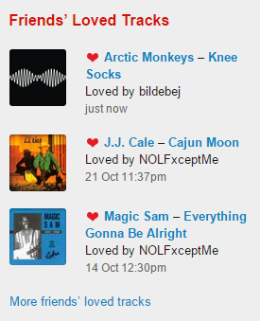
Example: Causal effect of a social news feed
Friends on a social network may Like similar items
E.g. on Last.fm, friends of a user may like similar music to the user
This may be due to influence, or
simply due to homophily
Causal question: Given only
log data, how can we determine
social influence due to the newsfeed,
compared to homophily effects?

Slide 118
Example: Causal effect of a social newsfeed
Solution: Use matching based on past items liked by each user, to create control group of non-friends that are as similar to a user as her friends.
f5
n5
f1
n1
u
f4
u
n4
f2
f3
n2
n3
Ego Network
Non-Friends
Sharma-Cosley (2015), Aral-Muchnik-Sundarajan (2009)

Slide 119
Caveat: Causal effect only if assumed graphical model is correct
There might be unknown and unobserved causes that might affect an Algorithm’s CTR.
E.g. early adopters, more tech-savvy, or another characteristic.
There might be known unobserved user features.
E.g. their age or the context in which they use an online system.
At best, with only observational data, we can obtain strong hints to causality.

Slide 120
5. Many of these techniques can be combined

Slide 121



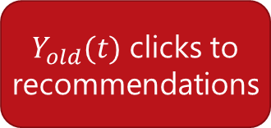

Remember, we are always looking for the ideal experiment with multiple worlds
Naïve estimate
$$Y_{new}(t)−Y_{old}(t−1)$$
Old Algorithm
$Y_{old}(t−1)$ clicks to recommendations
Causal estimate
$$Y_{new}(t)−Y_{old}(t)$$
New Algorithm
Old Algorithm
$Y_{new}(t)$ clicks to recommendations
$Y_{old}(t)$ clicks to recommendations
Cloned user

Slide 122
Example: Randomization + Instrumental Variable
Fisher example: You could not randomize over plots, but can randomize which farmers get fertilizers
Algorithm example: You cannot remove recommendations at random, but could advertise a focal product to a random subset of people on the homepage.

Slide 123
Random assignment as an instrument
Unobserved Confounders (U)
As-If-Random
$$(Z \text{∐ }\text{U}\text{)}$$
Random assignment(Z)
Cause (X)
Outcome (Y)
$$(Z ∐ Y | X,U)$$
Exclusion

Slide 124
Random assignment as an instrument
Unobserved Confounders (U)
Random assignment(Z)
Cause (X)
Outcome (Y)

Slide 125

Can use this variation to compute causal effect
An increase in Z can lead to a change in Y only through X.
So change in Y is a product of change in Z->X and X->Y arrows.
Compare the extent by which random assignment affects X versus Y.
Causal effect (X->Y) = $\frac{Y_{z=1 }−Y_{Z=0}}{X_{z=1 }−X_{Z=0}}$

Slide 126
II.D. Key takeaways

Slide 127
Three steps to causal inference
Model
Use a causal graphical model. Make your assumptions explicit even if it is cumbersome.
Identify
Use the graph to identify the effect you are after., or check if your desired identification strategy is valid (BEFORE looking at the data)
Estimate
Use any statistical method to estimate the identified effect.

Slide 128
Estimating causal effects: Best practices
Whenever possible, use randomization.
If number of output items low, consider using explore-exploit methods.
If randomization is not feasible, consider exploiting natural experiments.
Better to consider multiple sources of natural experiments.
If natural experiments are hard to find, consider using conditioning methods.
Use them as strong hints for causality.

Slide 129
Causal inference is tricky Correlations are seldom enough. And sometimes horribly misleading. Always be skeptical of causal claims from observational any data. More data does not automatically lead to better causal estimates.
http://tylervigen.com/spurious-correlations

Slide 130
III. Hands-on tutorial
Notes:
Do first ice cream and swimming, then do recommendation example.

Slide 131
Code and resources available at
http://www.github.com/amit-sharma/causal-inference-tutorial
Contact: amshar@microsoft.com, @amt_shrma

Slide 132
Prerequisites
Need Python, Jupyter notebook
Packages: numpy, pandas
1. Install them using:
pip install numpy pandas
pip install scikit-learn
(Optional)
pip install seaborn
2. Clone git repository
https://www.github.com/amit-sharma/causal-inference-tutorial

Slide 133
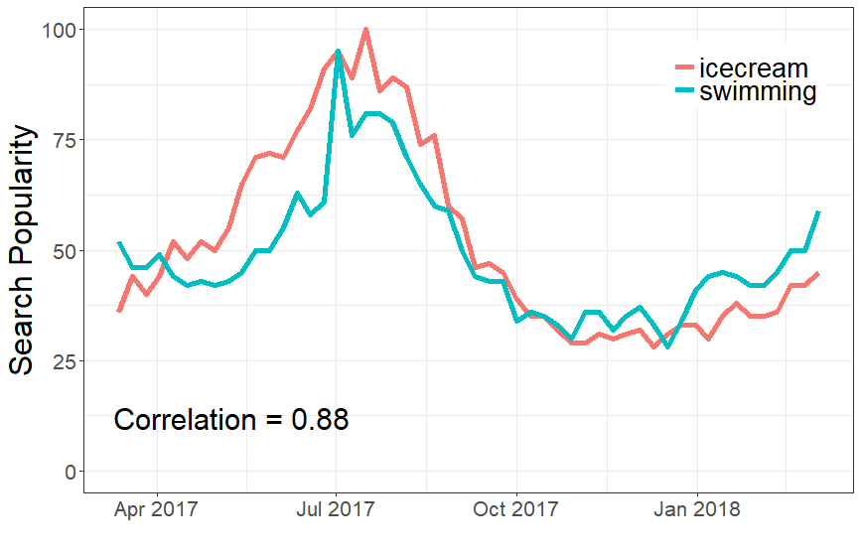
Example 1: Does having ice cream cause you to swim?

Slide 134
Step 1: Model the world
Temperature
?
Ice Cream
Swimming

Slide 135
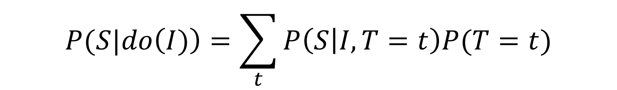
Step 2: Identify the causal effect
Temperature
Ice Cream
Swimming
$$P(S|do\left(I)\right)=\sum_{t}{P\left(S | I,T=t\right)P(T=t)}$$

Slide 136
Step 3: Estimate the effect
def linear_causal_estimate(df):
observed_common_causes = df[['w0']]
treatment_2d = df["Treatment"].values.reshape(len(df["Treatment"]), -1)
features = np.concatenate((treatment_2d, observed_common_causes),
axis=1)
model = linear_model.LinearRegression()
model.fit(features, df["Outcome"])
coefficients = model.coef_
estimate= {'value':coefficients[0],
'intercept':model.intercept_}
return estimate
estimate = linear_causal_estimate(df)
print("Causal Estimate is " + str(estimate["value"]))

Slide 137

Step 3: Estimate the effect

Slide 138
Example 2: Effect of recommendations
Study the effect of app store recommendation system.
Using system logs,
Compare two recommendation algorithms.
Estimate the causal effect of recommendations.

Slide 139
I. Which of the two algorithms is better?
Situation: Two Algorithms, A and B, were used to show app recommendations on the Store.
Data: System log data recording users’ visits.
Causal question: Which algorithm leads to higher click-through rates?

Slide 140
Loading user-app visits data
Jupyter notebook
user_app_visits_A = pd.read_csv("../datasets/user_app_visits_A.csv)
user_app_visits_B = pd.read_csv("../datasets/user_app_visits_B.csv)

Slide 141

Dataset at a glance

Slide 142
Data description
user_id: Unique ID for user
activity_level: User’s activity level. Discrete (1:Lowest, 4:Highest)
product_id: Unique ID for an app
category: Category for an app (e.g. productivity, music, etc.)
is_rec_visit: Whether the app visit came through a recommendation click-through.
rec_rank: Rank in the recommendation list (only top-3 apps shown to user, -1 means that app was not in the recommendation list)

Slide 143
What’s in the dataset?
> nrow(user_app_visits_A)
[1] 1,000,000
> length(unique(user_app_visits_A$user_id))
[1] 10,000
> length(unique(user_app_visits_A$product_id))
[1] 990
> length(unique(user_app_visits_A$category)) [1] 10

Slide 144
Causal assumptions
We ask the system designers/look at the source code for the system.
Algorithm was selected based on activity level of users.
Further, CTR depends on
Activity level
Time of day
App category

Slide 145
Step 3: Estimate the effect of changing algorithm
Naïve estimate for comparing algorithms
Algorithm B appears to be better.

Slide 146

Step 1: Model the world

Slide 147
Step 2: Using backdoor criterion, identify correct variables on condition on

Slide 148
Step 3: Estimate the effect of changing algorithm
Stratified estimate for comparing algorithms
> stratified_by_activity_estimate(user_app_visits_A)
Source: local data frame [4 x 2]
activity_level stratified_estimate
1 1 0.1248852
2 2 0.1750483
3 3 0.2266394
4 4 0.2763522
> stratified_by_activity_estimate(user_app_visits_B)
Source: local data frame [4 x 2]
activity_level stratified_estimate
1 1 0.1253469
2 2 0.1753933
3 3 0.2257211
4 4 0.2749867

Slide 149
If we had conditioned on category…
> stratified_by_category_estimate(user_app_visits_A)
Source: local data frame [10 x 2]
category stratified_estimate
1 1 0.1758294
2 2 0.2276829
3 3 0.2763157
4 4 0.1239860
5 5 0.1767163
… … …
> stratified_by_category_estimate(user_app_visits_B)
Source: local data frame [10 x 2]
category stratified_estimate
1 1 0.2002127
2 2 0.2517528
3 3 0.3021371
4 4 0.1503150
5 5 0.1999519
… … …

Slide 150
I. Which of the two algorithms is better?
The two Algorithms lead to roughly the same CTR.
Answer: Both are equally effective.
Still, the CTR estimate must be an over-estimate of the causal effect of recommendations, as people might have visited some of the apps anyways.
How to estimate the causal effect?

Slide 151
II. What is the causal effect of the recommendation system?
Situation: Two Algorithms, A and B, were used to show app recommendations on the Store.
Data: System logs containing user-app visits.
Causal question: How many apps would users have visited in case no recommendations were shown?

Slide 152
Step 1, Model: Graphical model to estimate causal effect
We observe total recommendation click-throughs.
But some of them may be due to correlated demand.

Slide 153
Step 2, Identify: Using regression discontinuity analysis
We know that the Store only shows top-3 recommendations.
Comparing number of visits to the 4th ranked app (not shown to the user) with the 3rd ranked app can be used to estimate the effect of showing a recommendation.
(Assuming 3rd and 4th ranked apps are equally relevant to a user)

Slide 154
Step 3, Estimate: Discontinuity estimate for recommendations
> naive_observational_estimate(user_app_visits_A)
naive_estimate
[1] 0.200768
> ranking_discontinuity_estimate(user_app_visits_A)
discontinuity_estimate
[1] 0.121362
40% of app visits coming from recommendation click-throughs are not causal.
Could have happened even without the recommendation system.

Slide 155
IV. Advanced methods

Slide 156
Advanced methods
Inverse propensity weighting
Doubly robust estimation
Refutation: 4th step in causal analysis
(Model, Identify, Estimate, Refute)

Slide 157
IV.A. Inverse Propensity Weighting

Slide 158
Weighting to balance treatment and control
Suppose people who were shown a recommendation were really likely to find it.
So if we had a score for their likelihood to find it themselves, we could:
downweight the people who saw recommendations who had a higher likelihood
give higher weight to people who had a lower likelihood of finding it anyways
Turns out this creates a balanced dataset, assuming the likelihood is accurate.

Slide 159


Estimation
Naïve estimate
$$Y_{new}(t)−Y_{old}(t−1)$$
Old Algorithm
$Y_{old}(t−1)$ clicks to recommendations
Causal estimate
$$Y_{new}(t)/p(u)−Y_{old}(t)/p(u)$$
New Algorithm
Old Algorithm
$Y_{new}(t)$ clicks to recommendations
$Y_{old}(t)$ clicks to recommendations
Control users

Slide 160
Caveat
What if likelihood/propensity too low?
Leads to high variance estimates.
A single value can derail the estimate.
Can we combine the benefits of prediction and causal inference?

Slide 161
IV.B. Doubly robust estimation

Slide 162
Prediction + IPW
Use IPW as the unbiased estimate.
To reduce variance, add a term that is the output of a predictive ML model that tries to predict outcome variable.
Combine them in a special way to yield a property:
The estimate is unbiased if either the propensity is correctly estimated, or if the prediction model is accurate.

Slide 163




Simple example: Estimating average height of students in a class

Slide 164
IV.C. Refuting the obtained causal estimate

Slide 165
Causal estimate is a result of your assumptions
“Causal” part does not come from the data.
It comes from your assumptions that lead to identification.
The data is simply used for statistical estimation.
Critical to verify your assumptions. How?

Slide 166
Sanity check 1: Add random variables to your model
Can add randomly drawn common causes, or random instruments.
Rerun your analysis.
Does the causal estimate change?

Slide 167
Sanity check 2: Replace treatment by a placebo (A/A test)
Can randomize or permute the treatment.
Or match treatment and control to have the same distribution of the treatment variable.
Rerun your analysis.
Does the causal estimate change?

Slide 168
Sanity Check 3: Divide data into subsets (cross-validation)
Create subsets of your data.
Rerun your analysis.
Does the causal estimate change?

Slide 169
Sensitivity Analysis: How bad should a confounder be so that your estimate reverses?
Use simulation to add effect of unknown confounders.
Domain knowledge to guide reasonable values of the simulation.
Make comparisons to other known estimates.

Slide 170
Does smoking cause lung cancer?
Demographics
Genes
Smoking
Lung Cancer
Cornwell (1959) showed that the effect of Genes had to be 8 times any known confounder for the effect to go to zero.

Slide 171
Observational causal inference: Best practices
Always follow the four steps: Model, Identify, Estimate, Refute.
Refute is the most important step.
Aim for simplicity.
If your analysis is too complicated, it is most likely wrong.
Try at least two methods with different assumptions.
Higher confidence in estimate if both methods agree.

Slide 172
V. Hands-on exercise

Slide 173

Example 3: Estimating causal effect with many auxiliary variables
Use multiple methods
Add Step 4: Try to refute your own estimate.

Slide 174
VI. Case studies on online social systems

Slide 175
Studies
Distinguishing between homophily and influence
Measuring peer effects
Is running contagious?
Estimating counterfactuals in an online ad system
Measuring effect of marketing campaigns

Slide 176

Distinguishing homophily and contagion is impossible

Slide 177

Distinguishing homophily and contagion is impossible

Slide 178

Measuring peer effects

Slide 179

Measuring peer effects
Use randomized experiments to validate

Slide 180

Is running contagious?

Slide 181

Is running contagious?
Use weather as an instrument: Does rain in NYC cause your friends in LA to also run less?

Slide 182

Estimating causal effects in ad systems

Slide 183


Estimating causal effects in ad systems

Slide 184

Estimating effect of marketing campaigns

Slide 185

Estimating effect of marketing campaigns
Use synthetic controls.
Construct them by using Bayesian modeling.
Intuitive method when no controls present in the data.

Slide 186
VII. Further curiosity

Slide 187
1. Dealing with social networks
Networks mess up causal inference, because individual units are no longer connected.
The key assumption of independence of counterfactuals breaks.
If I treat a person, she might spread it (partially) to her friends, and so the assignment to friends is not completely randomized.
Think of a video sharing feature.

Slide 188
1. Dealing with social networks
Networks mess up causal inference, because individual units are no longer connected.
Possible solution: New Zealand.
Or better clustering of the network (Ugander et al.)
Or really complicated statistics (Eckles et al.).

Slide 189


2. Causal inference and machine learning
Causal inference ⬄ robust prediction
(Supervised) ML
Predicted value under the
training distribution
P(X,y).
$$P\left(X,y\right): y=k\left(X\right)+ε$$
Causal inference
Predicted value under the
counterfactual distribution
P’(X,y).
$$P^{′}\left(X,y\right):y= ?$$
Notes:
Say: Generalize to data distributions not seen in the training data
Say how to make prediction robust, and ci generalizable.
Whose paper? Remember to cite.

Slide 190
2. Causal inference and machine learning
Machine learning
Use causal inference methods for robust, generalizable prediction.
Causal inference
Use ML algorithms to better model the non-linear effect of confounders, or find low-dimensional representations.
In general, be wary of methods that have not been empirically tested, especially ones that you do not understand.
Notes:
Say: Generalize to data distributions not seen in the training data
Say how to make prediction robust, and ci generalizable.
Whose paper? Remember to cite.

Slide 191
3. Automating causal inference
Causal inference is tricky, requires patience and ingenuity.
But also a lot of mechanical and statistical parts.
To what extent can tasks of modeling, identification, estimation and refutation be automated like ML?
-- Finding the best method based on data
-- Mining natural experiments from data
Really, really nascent field.

Slide 192
Causal inference: Best practices
Always follow the four steps: Model, Identify, Estimate, Refute.
Refute is the most important step.
Aim for simplicity.
If your analysis is too complicated, it is most likely wrong.
Remember the order for validity: Randomization, Natural experiments, Conditioning.
Consider observational methods as strong hints.

Slide 193
Thank you!
Amit Sharma
Postdoctoral Researcher, Microsoft Research
amshar@microsoft.com
@amt_shrma

